Slide 1

MINI PROJECT 1 ZOMATO PRICE PREDICTION FOR TWO(REGRESSION)
BY
VIKASH KUMAR DIWAKAR
AI/ML INTERN, SCIFOR TECHNOLOGY

Slide 2
Why Analysing the Price?
1.Average Order Value
The average amount spent by customers per order.
2. Customer Acquisition Cost
The cost associated with acquiring a new customer.
3. Customer Lifetime Value
Predicting prices that optimize CLTV ensures long-term revenue growth, aligning price points with customer retention strategies.

Slide 3
Introduction
In today’s competitive food delivery market, optimizing pricing strategies is crucial for both customer satisfaction and business profitability. This project focuses on developing a predictive model to determine optimal price points for restaurants listed on Zomato. By analyzing historical pricing data, customer purchase behavior, and restaurant characteristics, we aim to identify patterns that can guide pricing decisions. This presentation will walk you through the methodology, key findings, and business implications of our analysis.

Slide 4
Problem Statement
Zomato Data Analysis is one of the most useful analysis for foodies who want to taste the best cuisines of every part of the world which lies in their budget. This analysis is also for those who want to find the value for money restaurants in various parts of the country for the cuisines. Additionally, this analysis caters the needs of people who are striving to get the best cuisine of the country and which locality of that country serves that cuisines with maximum number of restaurants.

Slide 5




OVERVIEW OF ANALYSIS
Data Cleaning
Data Exploration
Predictive Modeling
Understand the structure of the dataset and clean data before analysis
Uncover initial patterns, characteristics, and points of interest using visual exploration
Formulate a statistical model to forecast an outcome using relevant predictors

Slide 6
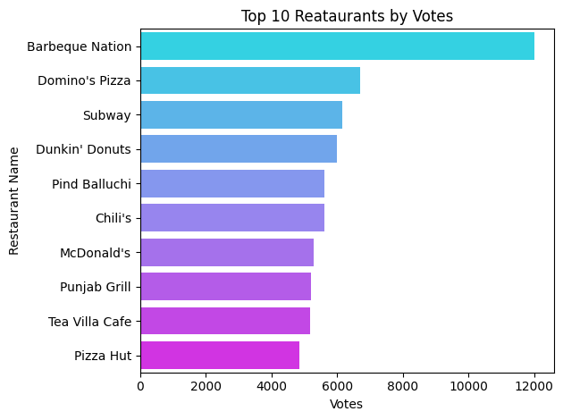
Top Restaurants
Brabeque Nation is the most polpular followed by Dominos and subway.
50% are international outlets.
Barbeque Nation has almost double votes than dominos.

Slide 7
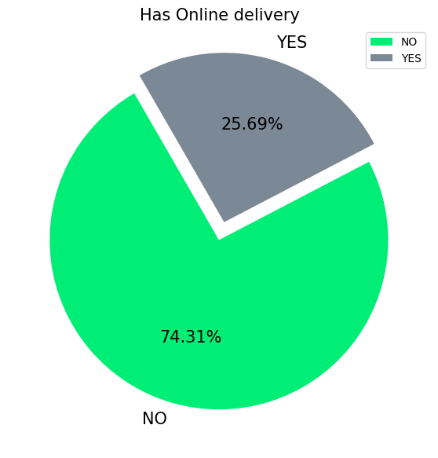
Online Delivery
Surprizingly only one-forth restaurants has online delivery facility.

Slide 8
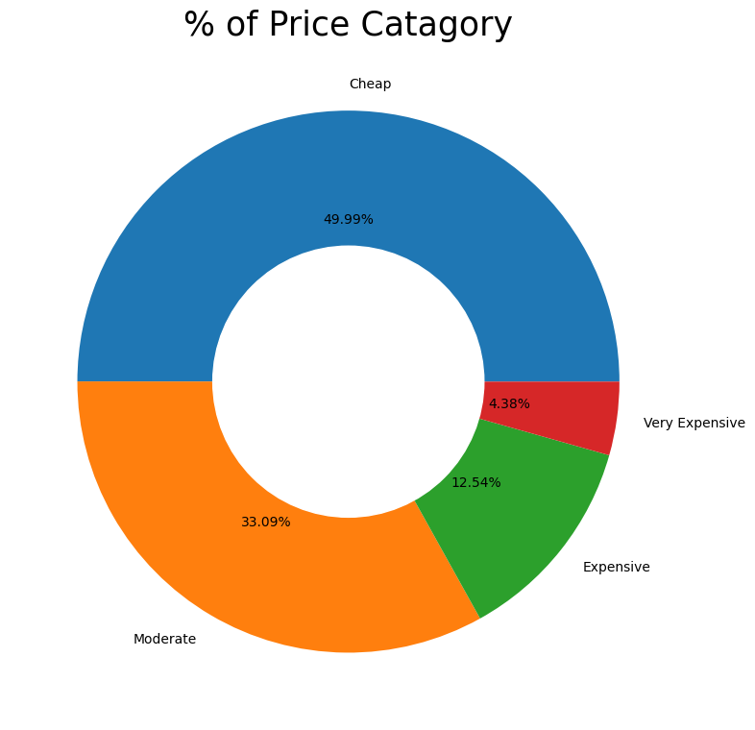
Price Catagory
50% of the restaurants offers cheap food (less than 500) followed by Moderate(between 500-1000) with 33%.
Roughly around 4% restaurants are Premimum.

Slide 9
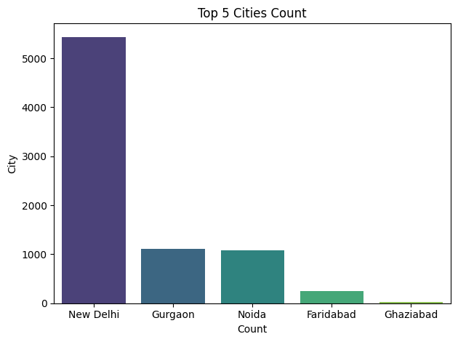
Top Cities
New Delhi has more than 5000 restaurants.
All top 5 cities are from North India.

Slide 10
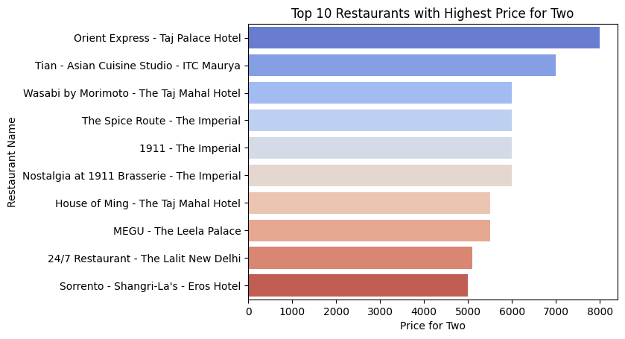
Restaurants Vs Price
All expensive restaurants are from lavish 5 stared hotels.
Prives are above 5000 rs which is very expensive.

Slide 11
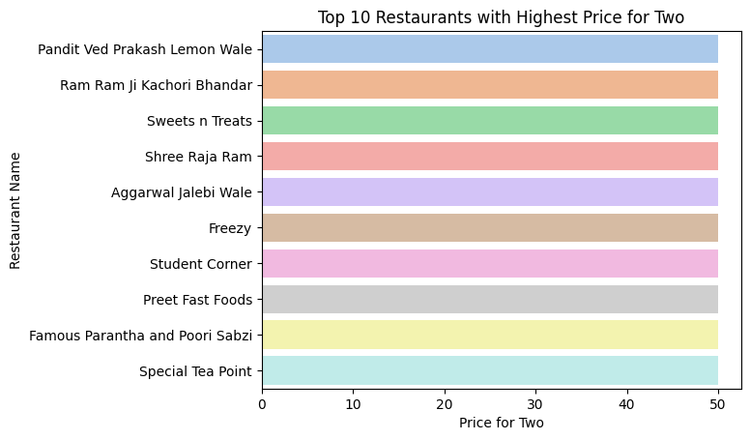
Cheap Price Restaurants
All are street food kind stalls and kiosks having average price of 50rs only.
Mainly tea and snacks food are there.

Slide 12
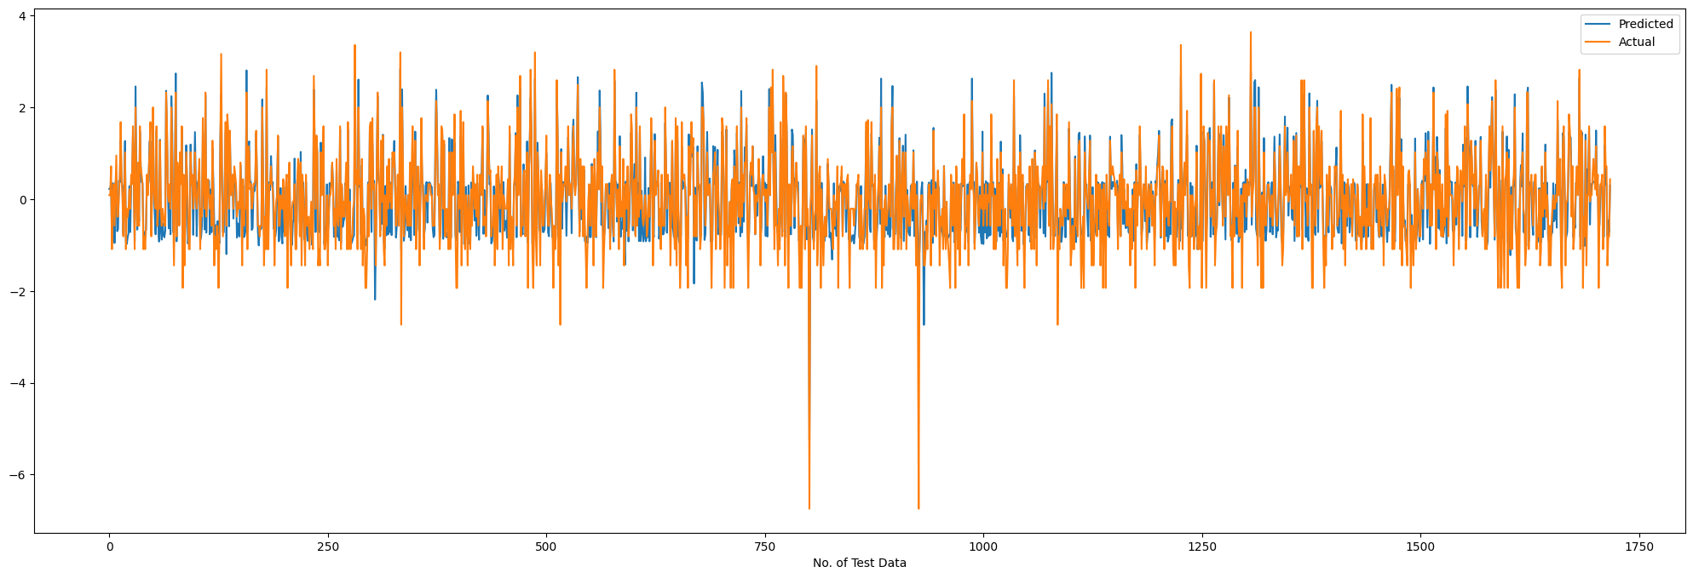
Gradient Boosting Algo.
Gradient Boosting is Giving almost 80% R2 score and trying predicting our taget vriable.

Slide 13
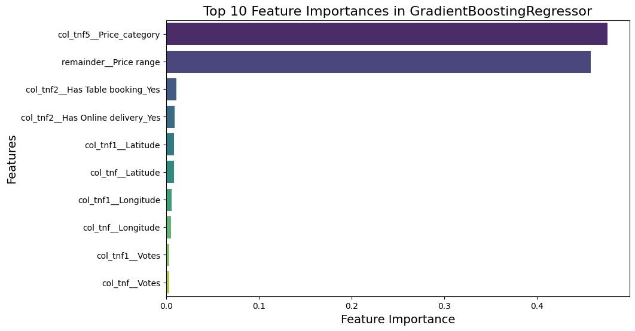
Feature importance
‘Price Category’ and ‘Price Range’ are the most important features.

Slide 14
Challenges
Reading the dataset and comprehending the problem statement.
Examining the business KPIs for app development and devising a solution to the problem.
Handling the error, duplicate and null values in the dataset.
Designing multiple visualizations to summarize the information in the dataset and successfully communicate the results and trends to the reader.

Slide 15
Conclusion
1.Training data R2 and Adjusted R2 Score
R2 score 0.83493
Adjusted R2 score 0.83464
2.Testing data R2 and Adjusted R2 Score
R2 score 0.8120
Adjusted R2 score 0.8107
3.Cross-validation score
cross-validation score 0.805
4.The performance metrics
MAE 0.314
MSE 0.183
RMSE 0.428

Slide 16

.
.

